Slide 1
Towards Learning-based
Inverse Subsurface Scattering
Chengqian Che, Fujun Luan, Shuang Zhao, Kavita Bala and Ioannis Gkioulekas
ICCP 2020
Presenter: Janu Kim (20190158)

Slide 2
Review: Progressive Denoising of Monte Carlo Rendered Images
Images rendered by Monte Carlo rendering has noise.
Denoisers remove important details too.
To address this problem, it finds optimal per-pixel mix parameter 𝛽
y + 𝛽 ∙ (𝑥 − 𝑦)

Slide 3
Towards Learning-based
Inverse Subsurface Scattering

Slide 4
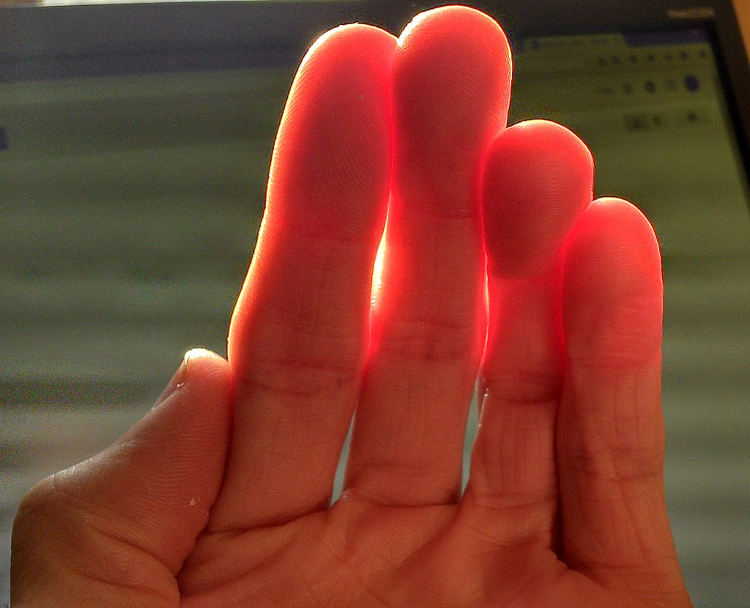
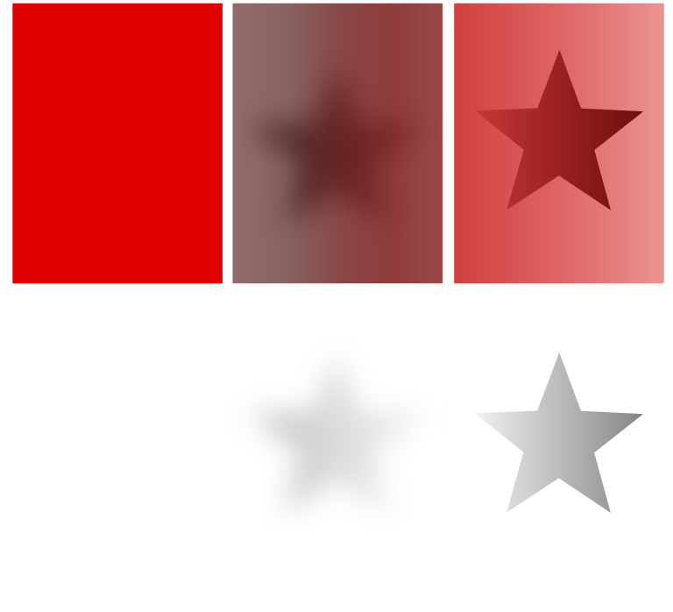
What is Subsurface Scattering?
Light penetrates and interacts within a translucent material, creating a softened illumination effect visible on the material's surface.
Translucent material e.g. skin, cloud, soap
Translucent skin
Opaque translucent transparent
https://upload.wikimedia.org/wikipedia/commons/thumb/5/50/Skin_Subsurface_Scattering.jpg/1024px-Skin_Subsurface_Scattering.jpg
https://upload.wikimedia.org/wikipedia/commons/thumb/1/1b/Opacity_Translucency_Transparency.svg/800px-Opacity_Translucency_Transparency.svg.png

Slide 5
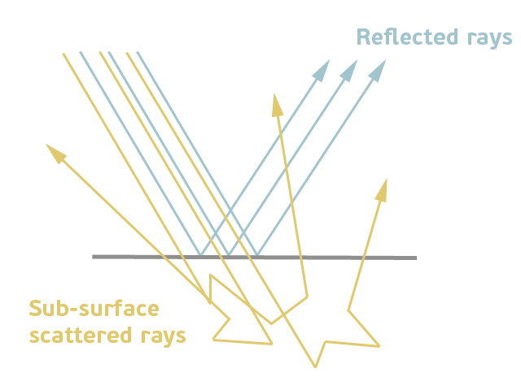
What is Subsurface Scattering?
Light undergoes multiple scattering events inside the object and emerges from a different location.
https://help.autodesk.com/view/ARNOL/ENU/?guid=arnold_user_guide_ac_standard_surface_ac_standard_subsurface_html

Slide 6
Towards Learning-based
Inverse Subsurface Scattering

Slide 7
What is Inverse Scattering?
Parameters of material π = (σ_{t}, α, g)
This paper assumes that parameters are constant inside the object
Parameter example)
  Extinction coefficient σ_{t}
  Volumetric albedo α
  Phase function p(θ), g
  Scattering coefficient σ_{s} = α · σ_{t} …

Slide 8

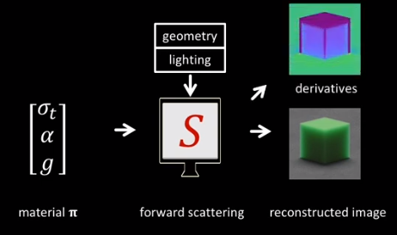
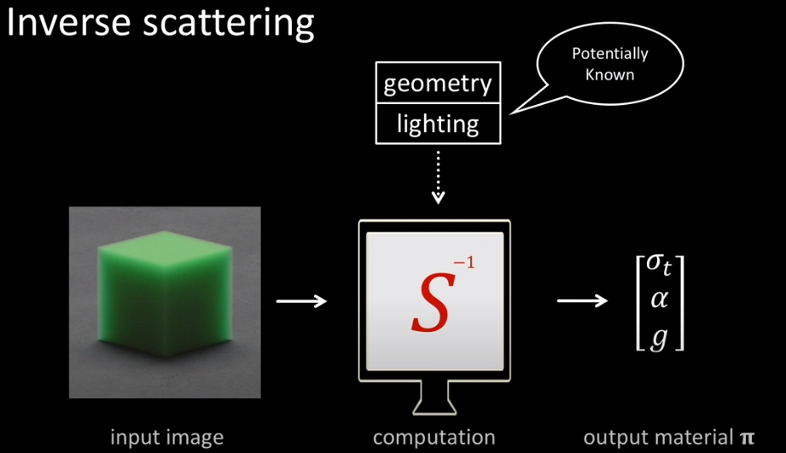
What is Inverse Scattering?
Forward scattering
  Parameters π -> Image
Inverse scattering
  Image -> parameters π

Slide 9
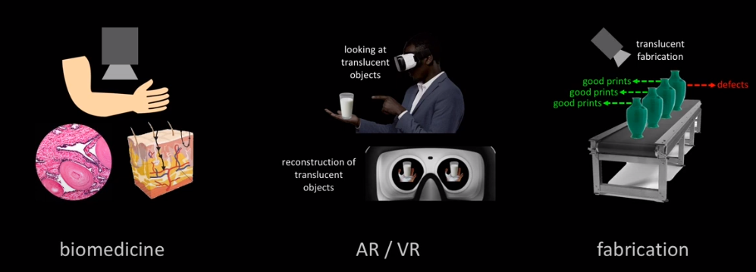
What is Inverse Scattering for?

Slide 10
Towards Learning-based
Inverse Subsurface Scattering

Slide 11
Contents
Backgrounds: Analysis by Synthesis
Motivation
Methods
Experiments
Takeaways

Slide 12

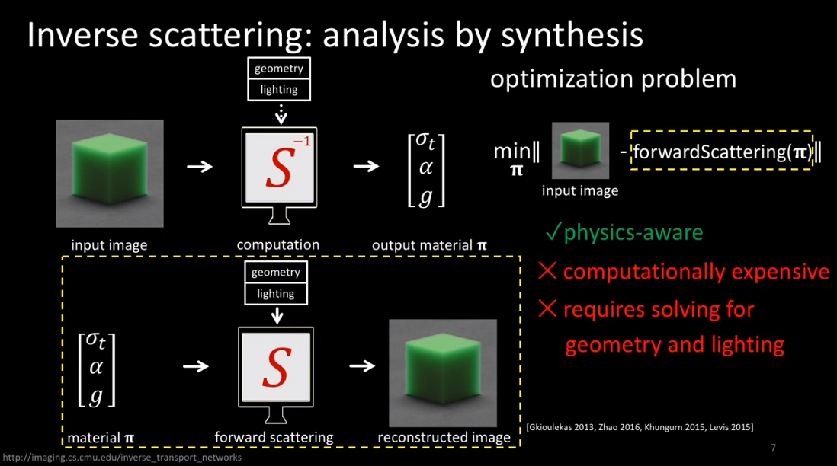
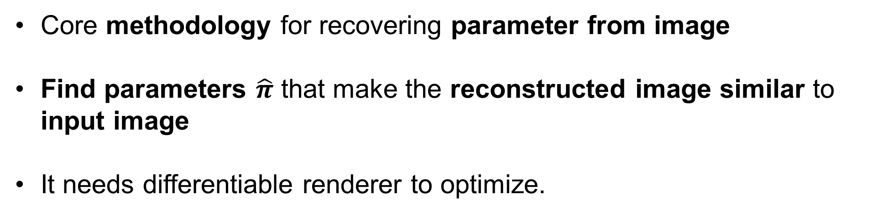
Backgrounds: Analysis by Synthesis
Core methodology for recovering parameter from image
Find parameters $\hat{π}$ that make the reconstructed image similar to input image
It needs differentiable renderer to optimize.

Slide 13
Backgrounds: Analysis by Synthesis
🙂
Broad applicability
  Able to deal with translucent materials
Physics-aware
☹️
Computationally expensive
Susceptible to local minima (similarity relation)
Require information such as shape and lighting

Slide 14
Motivation
Cons of analysis by synthesis
  Expensive, susceptible to local minima, requiring shape and lighting information and optimized for every image
“How about using Deep Learning to this inverse scattering problem?”
Computational efficiency of learning-based approaches
+
The applicability of analysis by synthesis approaches
New Architecture => Inverse Transport Network(ITN)

Slide 15
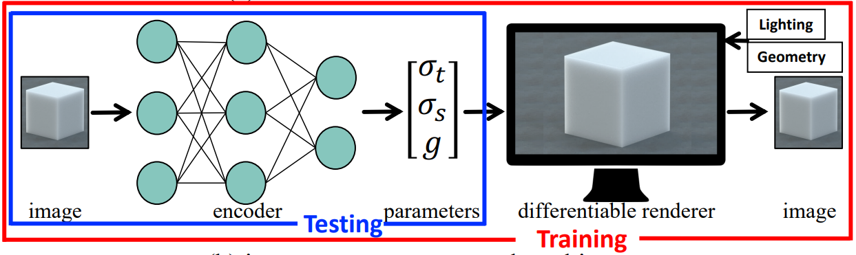
Overview
Goal
  Given images of translucent object, use learning to infer the optical parameters of unseen scene(with unknown shape and lighting) in physics-aware and efficient way
Inverse Transport Network(ITN)
with physically-accurate differentiable Monte Carlo renderer

Slide 16
Methods
Inverse Transport Network (ITN)
Similarity Relation
  Similarity-aware Parameterization
  Weight Map

Slide 17
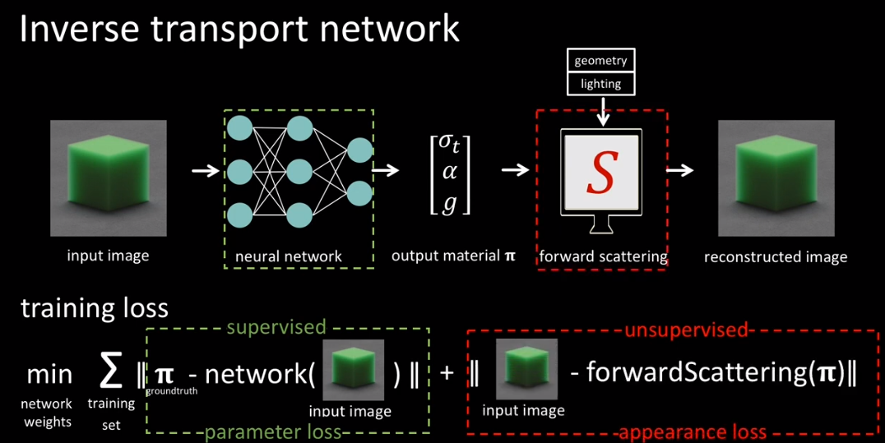
Methods: Inverse Transport Network (ITN)
Training
Testing
Renderer

Slide 18
Methods: Inverse Transport Network (ITN)
Computationally-efficient at testing time
Do not require shape and lighting
Physics-aware
Renderer

Slide 19
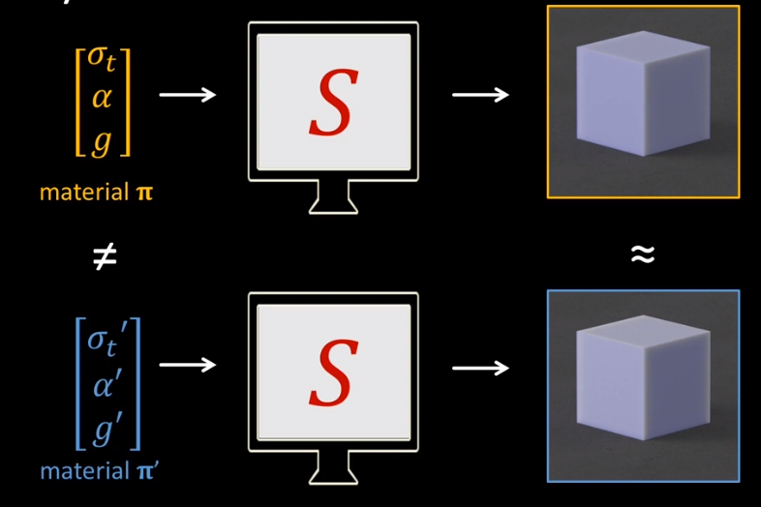
Problem) Similarity Relations
Different parameters π -> but similar Images

Slide 20
Methods to Address Similarity Relations
Similarity-aware Parameterization
  Change parameter set
  π = (σ_{t}, α, g) -> π_{r} = (σ_{s}, σ_{a}, σ^{r}_{s})
  Insights from the physics of radiative transfer

Slide 21
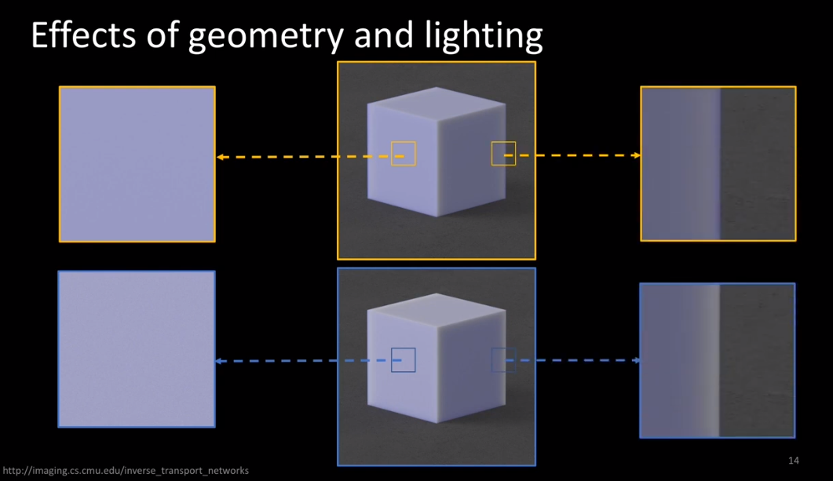
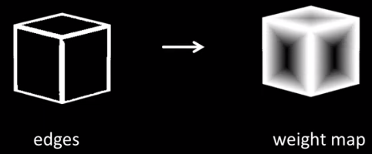
Methods to Address Similarity Relations
2) Weight Map
  Pixelwise
  Emphasize informative regions (edges)
  Used when reconstructing image

Slide 22
Experiments
Networks
Dataset
Evaluation
Results
Additional results
  Initialization of Analysis by Synthesis
  Real Photograph

Slide 23
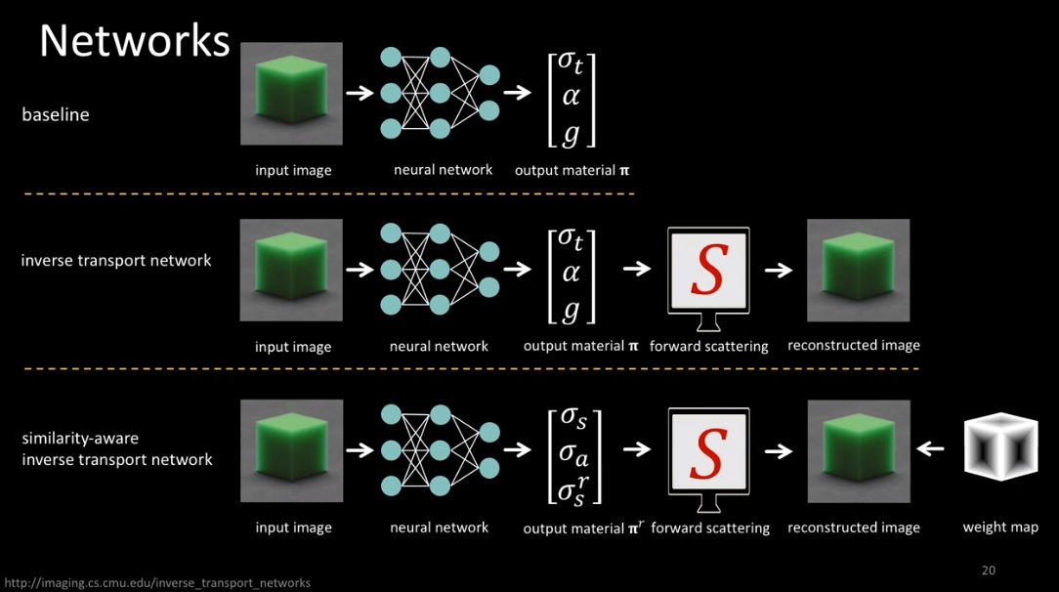
Experiments: Networks
Regression Network (RN): baseline
Inverse Transport Network (ITN)

Slide 24
Experiments: Networks
Default parameter
  (naive)
Similarity-aware Parameterization
  (similar)
Weight Map
  (map)

Slide 25
Experiments: 5 Networks
- RN+naive - RN+similar
- ITN+naive
- ITN+similar
- ITN+similar+map

Slide 26
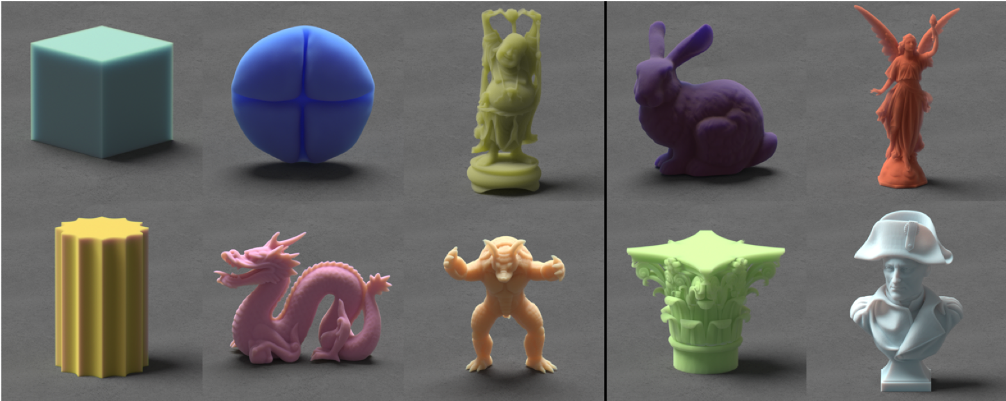
Experiments: Dataset
Synthesized images of translucent object
Shape, lighting and parameters vary (ground truth)
6k for training, 7k for testing (no overlapping shape and lighting)

Slide 27

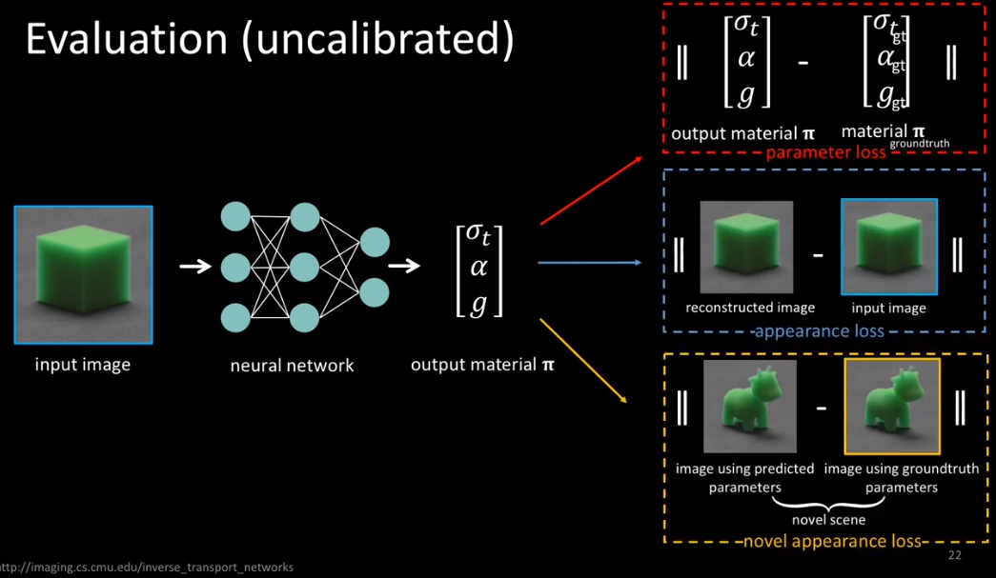
Experiments: Evaluation
Parameter
Appearance (compare images)
Novel appearance (compare images)
  Parameters + new shape, lighting

Slide 28
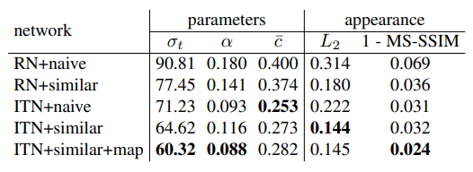
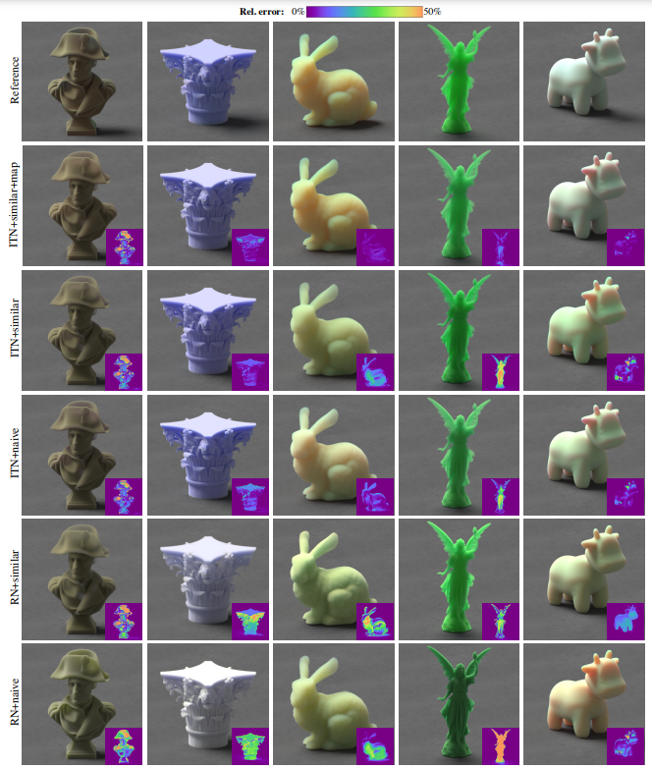
Experiments: Results
Parameter & Appearance

Slide 29
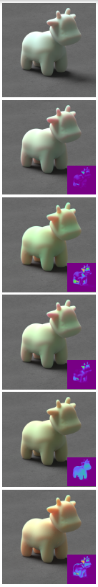
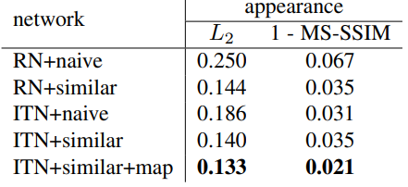
Experiments: Results
Novel appearance; groundtruth/output parameters + new shape & lighting
Reference
ITN+similar+map
ITN+similar
ITN+naive
RN+similar
RN+naive

Slide 30
Experiments: Initialization of Analysis by Synthesis
Analysis by Synthesis produce more accurate parameter than ITN if shape and lighting are given
40 images from testing set, initialize analysis by synthesis to output parameter of networks
Accelerate its convergence and improve quality of parameter

Slide 31
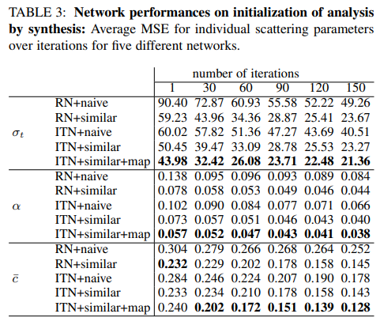
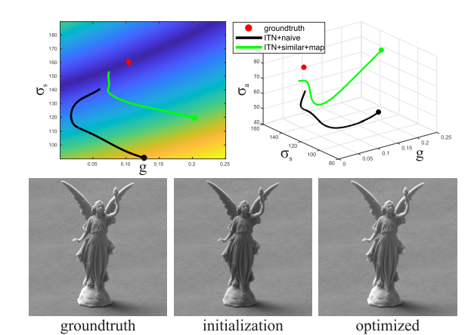
Experiments: Initialization of Analysis by Synthesis
40 images from testing set, initialize analysis by synthesis to output parameter of networks

Slide 32
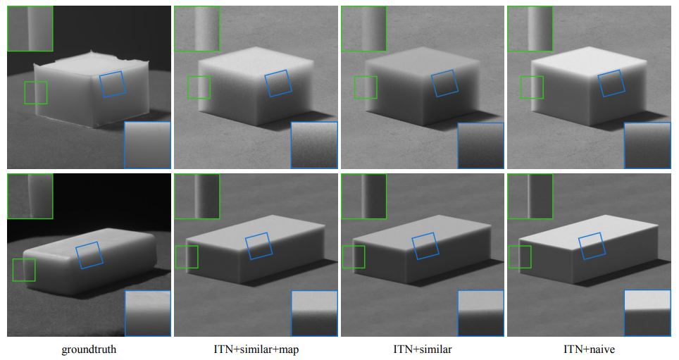
Experiments: Real Photograph
Input: real images (no shape and lighting information)
Render w/ predicted parameters and approximate shape and lighting
Good quality of importance features of translucent appearance (edge)
Silicon cube
Soap bar

Slide 33
Overview
Goal
  Given images of translucent object, use learning to infer the optical parameters of unseen scene(with unknown shape and lighting) in physics-aware and efficient way
Inverse Transport Network(ITN)
with physically-accurate differentiable Monte Carlo renderer

Slide 34
Overview
Goal
  Given images of translucent object, use learning to infer the optical parameters of unseen scene(with unknown shape and lighting) in physics-aware and efficient way
Inverse Transport Network(ITN)
with physically-accurate differentiable Monte Carlo renderer
ITN, parameterization, weight map
=> produce scattering parameter of unseen scene of translucent object
in physically accurate and efficient way

Slide 35
Takeaways: First step!
Contributions: First step
  To use deep learning for inverse scattering problem
  To use physically accurate Monte Carlo differentiable renderer instead of an approximate one
Future work
  Investigation of more general learning architectures that intelligently combine neural networks with physics-based light transport simulation

Slide 36
Thank you :)
References
  Authors’ paper and video
  In each slide

Slide 37
Quiz
Student ID:
Name:
Choose one correct option for “Inverse Transport Network”
  ITN isn’t related to deep learning
  ITN always has bigger loss than RN in this experiment
  ITN uses renderer during training
  ITN doesn’t need information about shape and lighting during training
Select an appropriate explanation for “similarity relations”
  Parameters are same, and images are similar
  Parameters are different, and images are similar
  Parameters are same, and images are different
  Parameters are different, and images are different

